Slide 1

EVALUATE STUDENT SUMMARIES
Team 3 -
Daniel Palmor
Ofek Levi
Elad Salama
May Siva

Slide 2

The CHALLENGE
The goal of this competition is to assess the quality of summaries written by students in grades 3-12. We'll build a model that evaluates how well a student represents the main idea and details of a source text, as well as the clarity, precision, and fluency of the language used in the summary.

Slide 3

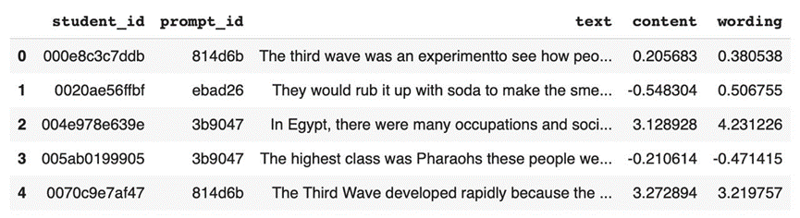
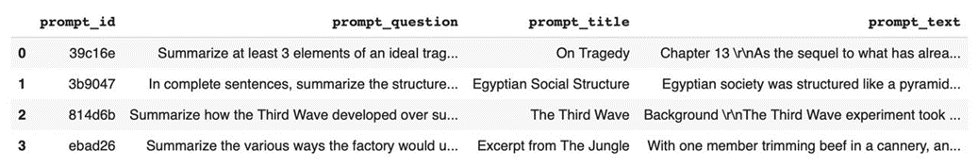
THE DATA
summaries_train.csv - Summaries in the training set:
prompts_train.csv - The four training set prompts:

Slide 4
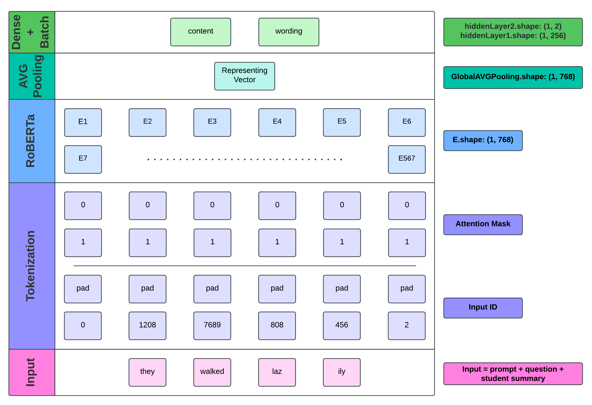

Slide 5
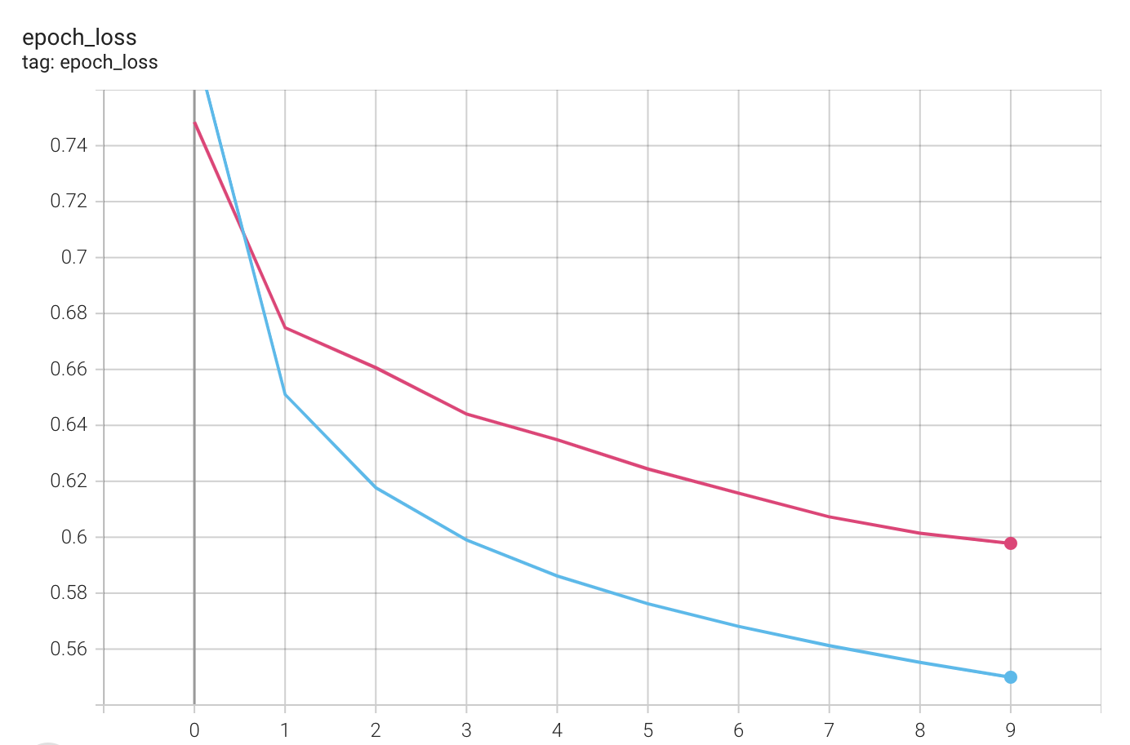
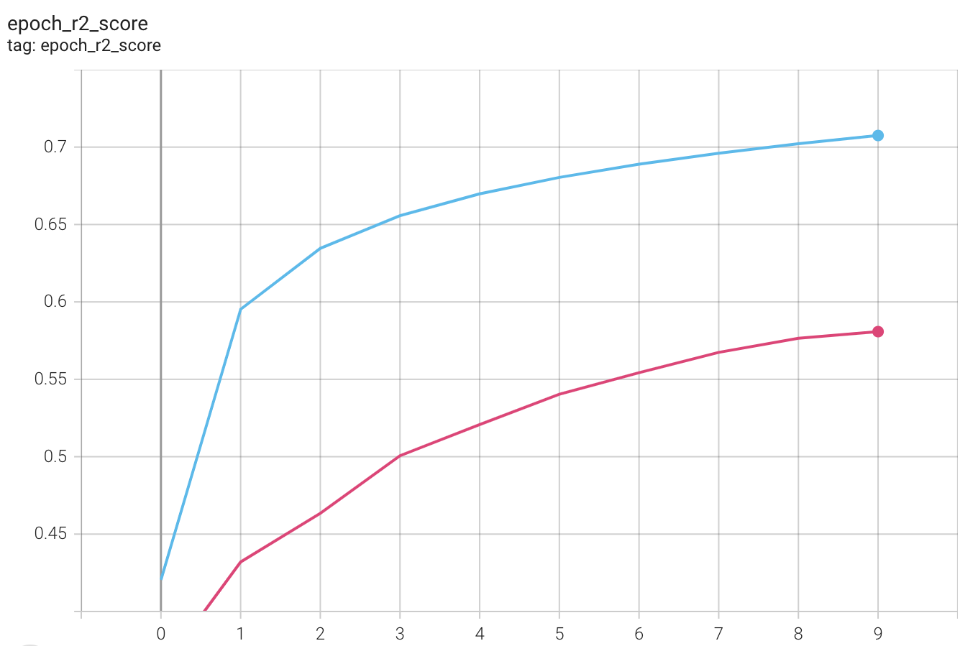
Results
train
validation
MCRMSE Loss
r2 Score
Epochs
Epochs

Slide 6

FUTURE PLANS
1
kfold Cross Validation
2
Data Augmentation
3
Adjusting Parameters

Slide 7

THANK YOU FOR LISTENING!

